Slide 1
Chapter 9-2
Operating System Service Routines
计算机系统概论
Introduction to Computing Systems
（ CS1002A.01）
苗付友
mfy@ustc.edu.cn
2025 Fall
计算机科学与技术学院
School of Computer Science and Technology

Slide 2
Outline
1
1
Review
Review
1
2
Review
TRAP Routines
3
3
A Machine Structure：von Neumann Model
Operating System Service Routines
3
4
A Machine Structure：von Neumann Model
Data Type Conversion

Slide 3
Today: CONTROL in Von Neumann Model

Slide 4
Control Instructions for System Calls
15
14
13
12
11
10
9
8
7
6
5
4
3
2
1
0
BR
0
0
0
0
n
z
p
PCoffset9
JSR
0
1
0
0
1
PCoffset11
JSRR
0
1
0
0
0
0
0
BaseR
0
0
0
0
0
0
RTI
1
0
0
0
0
0
0
0
0
0
0
0
0
0
0
0
JMP
1
1
0
0
0
0
0
BaseR
0
0
0
0
0
0
RET
1
1
0
0
0
0
0
1
1
1
0
0
0
0
0
0
TRAP
1
1
1
1
0
0
0
0
TrapVector8

Slide 5
Today: CONTROL in LC-3 Data Path
₁₆
GatePC
₁₆
GateMARMUX
LD.PC
PC
DR
₃
MARMUX
+1
REG FILE
₁₆
₂
PCMUX
₁₆
₁₆
₁₆
₁₆
₁₆
LD.REG
Control Unit
SR2
OUT
SR1
OUT
[7:0]
SEXT
SR2
₃
SR1
₊
₃
ADDR2MUX
MUX
MUX
ADDR1MUX
₁₆
₁₆
[10:0]
₁₆
₁₆
₁₆
₁₆
₁₆
SEXT
[8:0]
LD.CC
₁₆
SEXT
FINITE STATE MACHINE
SR2MUX
[5:0]
SEXT
₁₆
N
Z
P
ALUK
_{A}
_{B}
[4:0]
SEXT
₂
ALU
LD.IR
IR
LOGIC
…
₁₆
₁₆
₁₆
RUN
GateALU
₁₆
GateMDR
₁₆
LD.MDR
MDR
MEMORY
MAR
LD.MAR
₁₆
INPUT
OUTPUT
MIO.EN
MUX
₁₆
MEM.EN,R,W

Slide 6
Outline
1
1
Review
Review
1
2
Review
TRAP Routines
3
3
A Machine Structure：von Neumann Model
Operating System Service Routines

Slide 7
System Calls
Some ops. require specialized knowledge and protection
  Abstract I/O device registers and how to use them, Programmers don’t want to know this!
  Protection for shared I/O resources - isolate programs from OS
  Reuse of common code
Solution: service routines or system calls
  Low-level, privileged operations performed by operating system
1. User program invokes system call
2. Operating system code:
  Saves registers
  Performs operation
  Restores registers
3. Returns control to user program

Slide 8
LC-3 TRAP Mechanism
Provides set of service routines
  Part of operating system -- routines start at arbitrary addresses
  Up to 256 routines
Requires table of starting addresses
  Stored in memory (x0000 through x00FF)
  Used to associate code with trap number
  Called System Control Block (or Trap Vector Table)
Uses TRAP instruction
  Used by program to transfer control to operating system (w/ privileges)
  8-bit trap vector names one of the 256 service routines
Uses “RET” instruction(JMP R7)
  Returns control to the user program (w/o privileges)
  Execution resumes immediately after the TRAP instruction

Slide 9
LC-3 TRAP Routines(service routines)
  GETC (TRAP x20)
    Read a single character from KBD.
    ASCII copied in R0, R0[15:8] cleared.
  OUT (TRAP x21)
    Write R0[7:0] to CRT.
  PUTS (TRAP x22)
    Write a string to CRT. String address in R0.
  IN (TRAP x23)
    Print a prompt on the screen and read a single character from KBD.
    Character is echoed to Display. ASCII copied to R0[7:0] and R0[15:8] cleared.
  HALT (TRAP x25)
    Prints message on CRT & halts execution.
x0000
_{预留代码空间}
_{(实用代码空间)}
:
:
:
x0020
x0400
48
x0021
x0430
32(14)
x0022
x0450
96
x0023
x04A0
64(42)
x0024
x04E0
x0025
xFD70
:
:
:
x00FF
The LC-3 System
Control Block

Slide 10
TRAP Instruction
15 14 13 12
11 10 9 8
7 6 5 4 3 2 1 0
TRAP
1 1 1 1
0 0 0 0
trapvector8
Trap vector
  Identifies which system call to invoke
  Serves as index into table of service routine addresses
    LC-3: table stored in memory at 0x0000 – 0x00FF
    8-bit trap vector zero-extended to form 16-bit address
  Enters privileged mode
Where to go
  Lookup starting address from table; place in PC
Enabling return
  Save PSR, address of next instruction after TRAP ， PSR in system stack.

Slide 11
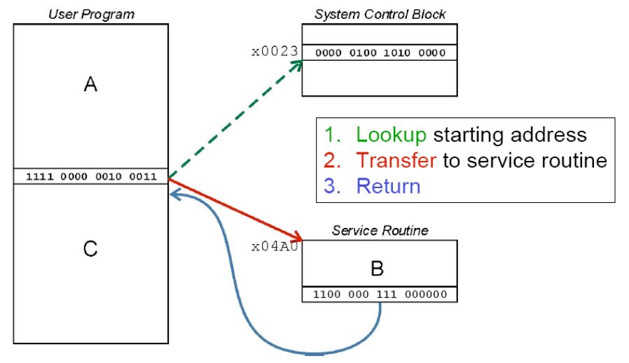
TRAP Mechanism Operation
①
②
RETI
③

Slide 12
Memory Regions for Privilege Mode
Supervisor stack
  in system space
  by operating system
  supervisor privilege required
User stack
  in user space
  by user program
  no supervisor privilege required
R6: stack pointer (SP) for the active stack
Saved_SSP / Saved_USP: save the SP not in use

Slide 13
TRAP System Call
Operation
TEMP=PSR;
if (PSR[15] == 1)
Saved USP=R6 and R6=Saved SSP;
PSR[15]=0;
Push TEMP,PC on the system stack
PC =mem[ZEXT(trapvect8)]

Slide 14
RTI instruction
15 14 13 12
11 10 9 8 7 6
5 4 3 2 1 0
RTI
1 0 0 0
0 0 0
0 0 0
0 0 0 0 0 0
RTI – return instruction
  How to return
    if (PSR[15] == 1) % if user mode
    Initiate a privilege mode exception;
    Else % if supervisor mode, pop PC, PSR on system stack
    PC = mem[R6]; R6 is the SSP, PC is restored
    R6 = R6+1;
    TEMP = mem[R6];
    R6 = R6+1; system stack completes POP before saved PSR is restored
    PSR = TEMP; PSR is restored
    if (PSR[15] == 1) % come to user mode
    Saved SSP=R6 and R6=Saved USP;

Slide 15
Outline
1
1
Review
Review
1
2
Review
TRAP Routines
3
3
A Machine Structure：von Neumann Model
Operating System Service Routines

Slide 16
Character Input Service Routine (IN, TRAP x23)
01; Service Routine for Keyboard Input
02 .ORIG x04A0 ;System call starting address
03
04;START ST R7,SaveR7 ;Save the linkage back to the
05; ;program?
06 ST R1,SaveR1 ;Save the values in the registers
07 ST R2,SaveR2 ;that are used so that they can
08 ST R3,SaveR3 ;be restored before RET
09
10;Output Newline on CRT
11 LD R2,Newline
12 L1 LDI R3,DSR ;Check DDR—is it free?
13 BRzp L1 ;Loop until monitor is ready
14 STI R2,DDR ;Move cursor to new clean line
15;
16;Output “Input a character”
17 LEA R1,Prompt ;Prompt is starting address
18 ;of prompt string
19 Loop LDR R0,R1,#0 ;Get next prompt character
20 BRz Input ;Check for end of prompt string
21 L2 LDI R3,DSR
22 BRzp L2
23 STI R0,DDR ;Write next character of prompt
24 ;string
25 ADD R1,R1,#1 ;Increment prompt point
26 BRnzp Loop

Slide 17
Character Input Service Routine (IN, TRAP x23)
27;Input a character from KB
28 Input LDI R3,KBSR ;Has a character been typed?
29 BRzp Input
30 LDI R0,KBDR ;Load it into R0
31
32;Echo the character on CRT
33 L3 LDI R3,DSR
34 BRzp L3
35 STI R0,DDR ;Echo input character to the
36 ;monitor
37;Output Newline on CRT
38 L4 LDI R3,DSR ;Check CRTDR—is it free?
39 BRzp L4
40 STI R2,DDR ;Move cursor to new clean line
41
42;Restore
43 LD R1,SaveR1 ;Service routine done, restore
44 LD R2,SaveR2 ;original values in registers.
45 LD R3,SaveR3 ;
46; LD R7,SaveR7 ;Restore linkage back
47; ;prior to RET?
48 RETI ;Return to calling program

Slide 18
Character Input Service Routine (IN, TRAP x23)
49;Memory for registers saved
50; SaveR7 .FILL x0000
51 SaveR1 .FILL x0000
52 SaveR2 .FILL x0000
53 SaveR3 .FILL x0000
54
55 DSR .FILL xF3FC
56 DDR .FILL xF3FF
57 KBSR .FILL xF400
KBDR .FILL xF401
;
59 Newline .FILL x000A ;ASCII code for newline
60 Prompt .STRINGZ”Input a character>”
61 .END

Slide 19
Character Output Service Routine (OUT, TRAP x21)
01 .ORIG x0430 ;System call starting address
02; ST R7,SaveR7 ;Save R7 so we can RET at the
03; ;bottom?
04 ST R1,SaveR1 ;R1 will be used to poll the CRT 06 ;hardware
07;Write the character
08 TryW LDI R1,CRTSR ;Get status
09 BRzp TryW ;Bit 15 on says CRT is ready
10 WIt STI R0,CRTDR ;Write character
11
12;Return from trap
13 Retn LD R1,SaveR1 ;Restore registers
14; LD R7,SaveR7 ;Restore jump return
15 RETI ;Return from trap
16
17 CRTSR .FILL xF3FC ;Address of CRT status register
18 CRTDR .FILL xF3FF ;Address of CRT data register
19 SaveR1 .FILL x0000
20; SaveR7 .FILL x0000
21 .END

Slide 20
A String Output Service Routine (PUTS,TRAP x22)
01;puts.asm (TRAP x22)
02;R0 points to null-terminated string
03;R0, R1 & R3 saved; R7 is lost.
04 .ORIG x0450
05; ST R7,SaveR7
06 ST R0,SaveR0
07 ST R1,SaveR1
08 ST R3,SaveR3
09;
10 LOOP LDR R1,R0,#0
11 BRz RETURN
12 L2 LDI R3,DSR
13 BRzp L2
14 STI R1,DDR
15 ADD R0,R0,#1
16 BR LOOP

Slide 21
A String Output Service Routine (PUTS,TRAP x22)
17 RETURN LD R3,SaveR3
18 LD R1,SaveR1
19 LD R0,SaveR0
20; LD R7,SaveR7
21 RETI
22;
23 CRTSR .FILL xF3FC
24 CRTDR .FILL xF3FF
25 SaveR0 .FILL x0000
26 SaveR1 .FILL x0000
27 SaveR3 .FILL x0000
28; SaveR7 .FILL x0000
29 .END

Slide 22
Halt the machine(HALT,TRAP x25)
01;
02;Service Routine for halting the machine
03;
04 .ORIG xFD70 ;Where this routine resides
05 ST R7,SaveR7 ;Save the linkage back to the
06 ;program?
07 ST R1,SaveR1 ;R1:a temp for MC register
08 ST R0,SaveR0 ;R0 is used as working space
09;
10;Print message that machine is halting
11 LD R0,ASCIINewLine
TRAP x21
LEA R0,Message
TRAP x22 ;Write a string(Message)to CRT
15 LD R0,ASCIINewLine
16 TRAP x21
17;
18;Clear bit 15 at xFFFF to stop the machine MCR-RUN latch
19 LDI R1,MCR ;Load MC register into R1
20 LD R0,MASK ;R0 = x7FFF
21 AND R0,R1,R0 ;Mask to clear the top bit
22 STI R0,MCR ;Store R0 into MC register

Slide 23
Halt the machine(HALT,TRAP x25)
23;
24;Return from HALT routine
25;{How can this routine return if the machine is halted above?}
26 LD R1,SaveR1 ;Restore registers
27 LD R0,SaveR0
28 LD R7,SaveR7 ;Restore trap return
29 RETI
30;
31;Some constants
32 ASCIINewLine .FILL x000A ;ASCII code for newline
33 SaveR0 .FILL x0000
34 SaveR1 .FILL x0000
35 SaveR7 .FILL x0000
36;
37 Message .STRING “Halting the machine.”
38 MCR .FILL xFFFE ;Address of MCR
39 MASK .FILL x7FFF ;Mask to clear the top bit
40 .END

Slide 24
Data Type Conversion
I/O
  Keyboard input routines read ASCII characters (not binary values)
  Console output routines write ASCII (‘s’ not “x73”)
Consider this program:
TRAP x23 ; input from keyboard
ADD R1, R0, #0 ; move to R1
TRAP x23 ; input from keyboard
ADD R0, R1, R0 ; add two inputs
TRAP x21 ; display result
TRAP x25 ; HALT
User inputs ‘2’ and ‘3’ -- what happens?
Result displayed: ‘e’
Why?
  ASCII '2' (x32) + ASCII '3' (x33) = ASCII 'e' (x65)

Slide 25
ASCII to Binary
Single digit numbers are trivial (subtract x30)
  E.g., ‘7’ is ASCII x37, x37 - x30 = x7
Input
  Assume we've read three ASCII digits (e.g., "259") into a memory buffer
How do we convert this to a number we can use?
  Convert first character to digit (subtract x30) and multiply by 100
  Convert second character to digit and multiply by 10
  Convert third character to digit
  Add the three digits together

Slide 26
ASCII to Binary Conversion Algorithm
Y
N

Slide 27
Multiplication
How can we multiply a number by 10?
  Approach 0
    Use the MUL instruction
  Approach 1
    Add <number> to itself 10 times
  Approach 2
    Add 10 to itself <number> times (better if number < 10)
  Approach 3
    Look it up! Only practical if number of multiplicands is small

Slide 28
Code for Lookup Table
; multiply R0 by 100, using lookup table
;
LEA R1, Lookup100 ; R1 = table base
ADD R1, R1, R0 ; add index (R0)
LDR R0, R1, #0 ; load from M[R1]
...
Lookup100 .FILL #0 ; entry 0
.FILL #100 ; entry 1
.FILL #200 ; entry 2
.FILL #300 ; entry 3
.FILL #400 ; entry 4
.FILL #500 ; entry 5
.FILL #600 ; entry 6
.FILL #700 ; entry 7
.FILL #800 ; entry 8
.FILL #900 ; entry 9

Slide 29
Complete ASCII to Binary Conversion Code
ASCII "259” to value 259
ASCIIBUF
3
R1

Slide 30
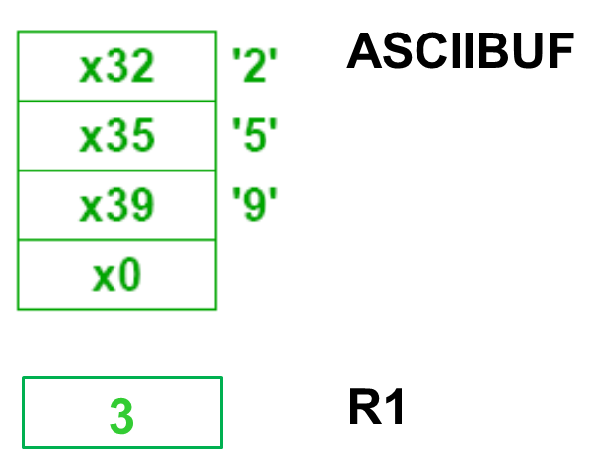
Complete ASCII to Binary Conversion Code (1 of 3)
; Three-digit buffer at ASCIIBUF.
; R1 tells how many digits to convert.
; Put resulting decimal number in R0.
ASCIItoBinary AND R0, R0, #0 ;clear result
ADD R1, R1, #0 ;test # digits
BRz DoneAtoB ;done if no digits
;
LD R3, NegZero ;R3 = -x30
LEA R2, ASCIIBUF ;ptr to the first digit
ADD R2, R2, R1 ;R2 =(R2)+(R1)
ADD R2, R2, #-1 ;points to ones digit
;
LDR R4, R2, #0 ;load digit
ADD R4, R4, R3 ;convert to number
ADD R0, R0, R4 ;add ones contribution
;

Slide 31
Complete ASCII to Binary Conversion Code(2 of 3)
ADD R1, R1, #-1 ;one less digit
BRz DoneAtoB ;done if zero
ADD R2, R2, #-1 ;points to tens digit
;
LDR R4, R2, #0 ;load ‘tens’ digit
ADD R4, R4, R3 ;convert to number
LEA R5, Lookup10 ;multiply by 10
ADD R5, R5, R4
LDR R4, R5, #0
ADD R0, R0, R4 ;adds tens contribution to total
;
ADD R1, R1, #-1 ;one less digit
BRz DoneAtoB ;done if zero
ADD R2, R2, #-1 ;points to hundreds digit
;
LDR R4, R2, #0 ;load digit
ADD R4, R4, R3 ;convert to number
LEA R5, Lookup100 ;multiply by 100
ADD R5, R5, R4
LDR R4, R5, #0
ADD R0, R0, R4 ;adds 100's contrib

Slide 32
Complete ASCII to Binary Conversion Code(3 of 3)
DoneAtoB RET
NegZero .FILL xFFD0 ;-x30
ASCIIBUF .BLKW 4
Lookup10 .FILL #0
.FILL #10
.FILL #20
...
Lookup100 .FILL #0
.FILL #100
.FILL #200
...

Slide 33
Binary to ASCII Conversion
Converting a 2's complement binary value to
a three-digit decimal number
  Resulting characters can be output using OUT
Instead of multiplying, we need to divide by 100
to get hundreds digit.
  Why wouldn't we use a lookup table for this problem?
  Subtract 100 repeatedly from number to divide.
First, check whether number is negative.
  Write sign character (+ or -) to buffer and make positive.

Slide 34
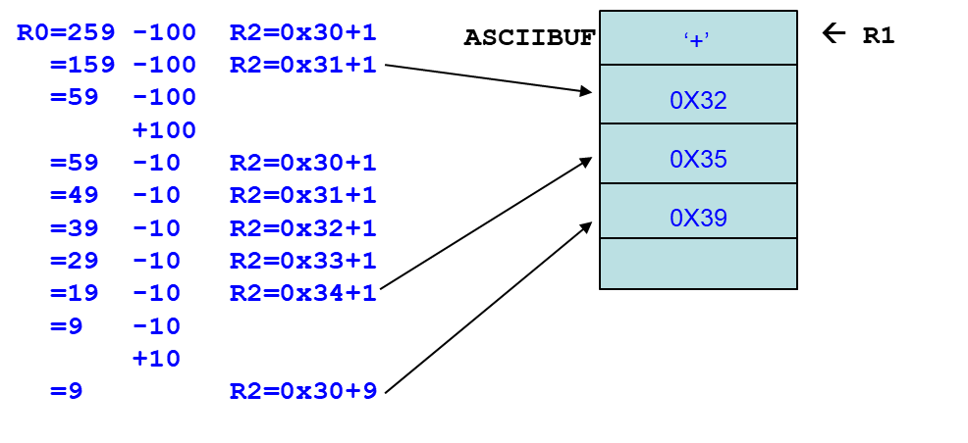
Binary to ASCII Conversion Code (1 of 3)
; Input: R0 is between -999 and +999.
; Output: Put sign character in ASCIIBUF, followed by three
; ASCII digit characters.
BinaryToASCII LEA R1, ASCIIBUF ;ptr to result string
ADD R0, R0, #0 ;test sign of value
BRn NegSign
LD R2, ASCIIplus ;store '+'
STR R2, R1, #0
BR Begin100
NegSign LD R2, ASCIIneg ;store '-'
STR R2, R1, #0
NOT R0, R0 ;convert value to pos
ADD R0, R0, #1
Begin100 LD R2, ASCIIoffset
LD R3, Neg100
Loop100 ADD R0, R0, R3
BRn End100
ADD R2, R2, #1 ;add one to digit
BR Loop100

Slide 35
Binary to ASCII Conversion Code(2 of 3)
End100 STR R2, R1, #1 ;store ASCII 100‘s digit
LD R3, Pos100
ADD R0, R0, R3 ;restore last subtract,
;因为多减了一个100
LD R2, ASCIIoffset
LD R3, Neg10
Loop10 ADD R0, R0, R3
BRn End10
ADD R2, R2, #1 ;add one to digit
BR Loop10
End10 STR R2, R1, #2 ;store ASCII 10's digit
ADD R0, R0, #10 ;restore last subtract
;
LD R2, ASCIIoffset
ADD R2, R2, R0 ;convert one's digit
STR R2, R1, #3 ;store one's digit
RET
;

Slide 36
Binary to ASCII Conversion Code(3 of 3)
ASCIIplus .FILL x002B ;plus sign ASCII code
ASCIIneg .FILL x002D ;neg sign ASCII code
ASCIIoffset .FILL x0030 ;zero’s ASCII code
Neg100 .FILL xFF9C ;-100
Pos100 .FILL x0064 ;100
Neg10 .FILL xFFF6 ;-10
R0=259 -100 R2=0x30+1
=159 -100 R2=0x31+1
=59 -100
+100
=59 -10 R2=0x30+1
=49 -10 R2=0x31+1
=39 -10 R2=0x32+1
=29 -10 R2=0x33+1
=19 -10 R2=0x34+1
=9 -10
+10
=9 R2=0x30+9
ASCIIBUF
_{‘+’}
_{0X32}
_{0X35}
_{0X39}
← R1

